Slide 1




Community Association:
Community Management Case Study
Stéphane Bidoul

Slide 2


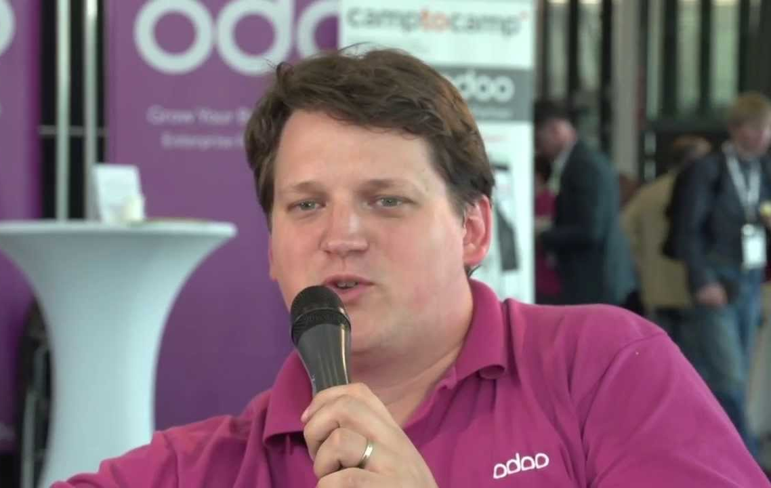
About
...

Slide 3

Odoo
Odoo is a modern all-in-one management software (aka ERP), focusing on ease of use and extensibility.
Broad functional scope
Web-based, Python, Postgres
Developed by Odoo SA
Open Source (LGPL) core (~80%)
Non-free Enterprise version built on top of the core
Modularity and extensibility

Slide 4
The Odoo Ecosystem
Odoo SA
Develops de core product (Community and Enterprise versions)
SaaS offering odoo.com
Marketing, road shows
Annual conference
Official Partner network
Odoo Community Association (OCA)

Slide 5


About the
Odoo Community Association

Slide 6

The Odoo community before OCA ...

Slide 7

…and the Odoo community today

Slide 8
Odoo Community Association (OCA)
The Odoo Community Association, or OCA, is a nonprofit organization whose mission is to promote the widespread use of Odoo and to support the collaborative development of Odoo features.
Fostering an Open Source ecosystem of Odoo modules.

Slide 9
Odoo Community Association (OCA)
Coordinate and organize collaborative work => reduce similar/redundant developments
Improve the partnership with Odoo SA => unified voice
Promote the use of the Odoo solution
Facilitate synergies, collaborations and fundraising efforts
Increase the quality of community contributions
Provide a partner-independent legal entity to protect intellectual properties
Provide resources for all OCA’s projects (infrastructure, funding, legal support)

Slide 10
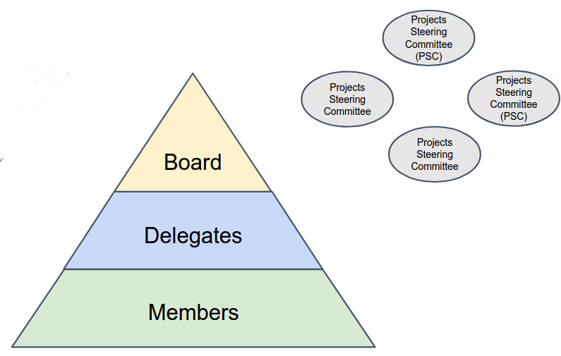
OCA – General Organisation
Non profit (Switzerland)
Organs
  Delegate Assembly (elect their peers, elect the board)
  Board (9p)
  Financial Auditors
  Project Steering Committees
Members
Contributors

Slide 11
OCA – Other Services
General assistance
  Licensing, IP protection
  Relations to Odoo SA the editor
Code sprints
  1 or 2 general code sprints / year
  Local sprints
Marketing
Newsletter

Slide 12
OCA – Technical Services to the community
Github repositories
Coding Conventions
Continuous Integration
  Travis (quality control)
  Runbot (ready-to test instances)
Translation platform
Packaging and distribution
  ~2100 packages on pypi.python.org

Slide 13
OCA – Budget
Expenses
  Code sprints
  Infrastructure and Administration
  Marketing
Revenue
  Membership (50€/year)
  Sponsorship
  (Selling Goodies)

Slide 14
OCA – Source Code
Any Open Source License (OSI Approved)
  Mostly AGPL v3
  Some LGPL
Contributor License Agreement
  Mandatory for all contributions (checked by a github bot)
  IP Protection
  Allow relicensing, should the need arise
  Entity (Company) or Individual

Slide 15
OCA – Some Stats
140 Github Projects
1600 Modules
1M LOC
200 Contributors (past 12 months)
270 Members
700 CLA signed
1800 open PR (!)
1100 open issues (!)

Slide 16
OCA – Successes
Increased quality
  CI, coding conventions, automated tests
  Functional review
Less redundant efforts
OCA modules are compatible with each other
Very active community

Slide 17
OCA – Future work
Attracting more reviewers
Attracting non-technical contributors
  Functional experts
Managing growth
  Backlog of PR/issues
  Maintenance, ownership of modules
  Maturity levels

Slide 18
@sbidoul stephane.bidoul@acsone.eu https://odoo-community.org
presentations@orderofthebee.org

